Slide 1
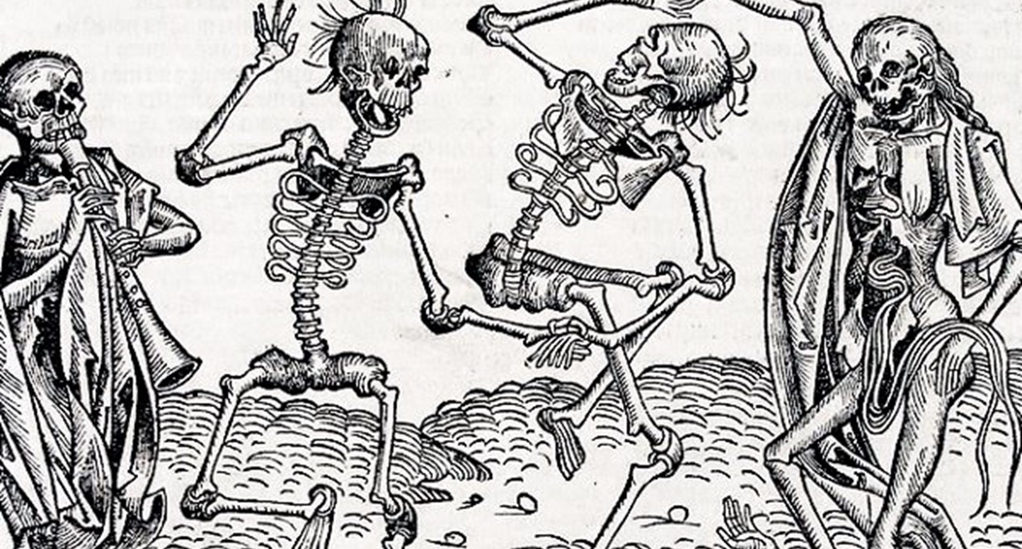
Black Death

Slide 2
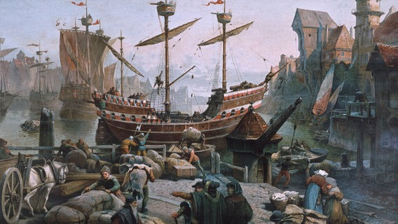
Messina, Italy October 1347
A group of ships loaded with trade goods arrives from Asia
People gathered on the docks to see the treasures that had arrived from the east
The merchants who boarded the ship discovered a horrifying surprise

Slide 3
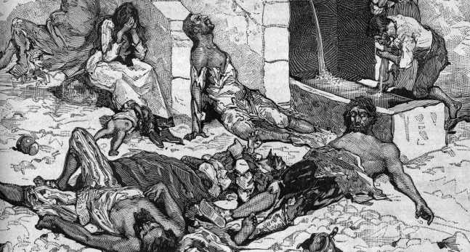
Most of the sailors on the ship were dead.
Those that were alive were gravely ill and covered in black boils that oozed blood and pus.

Slide 4
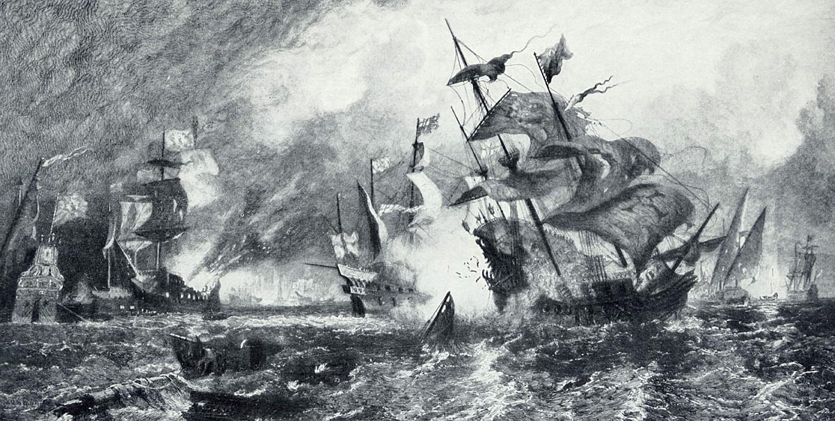
These “death ships” were ordered to leave the port immediately
But it was too late.
Over the next five years, the Black Death would kill more than 20 million people – nearly a third of Europe’s population

Slide 5
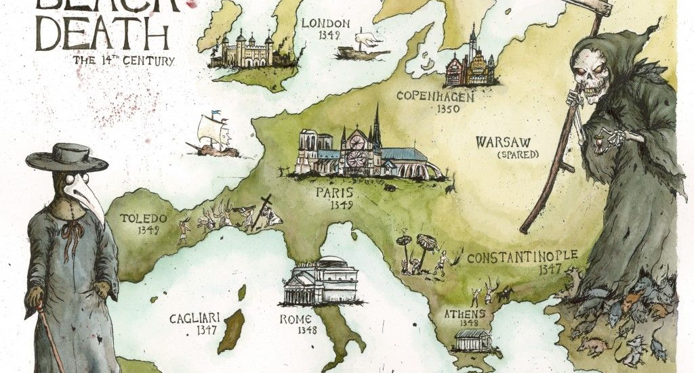
The plague started in Asia and within 3 years spread across the entire European continent.

Slide 6
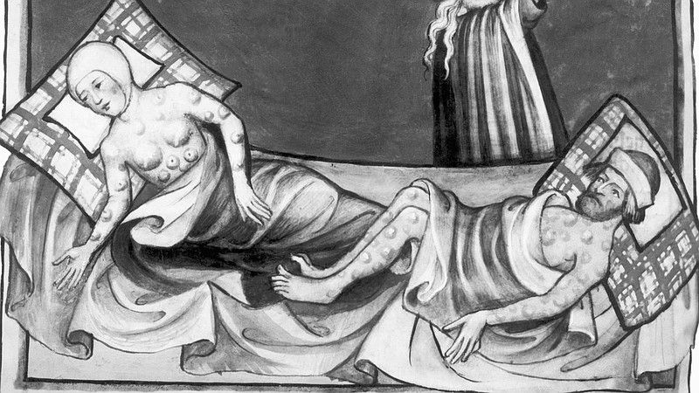
No one knew what caused the illness. In addition to bloody sores, there were other symptoms like fever, chills, vomiting, diarrhea, and aches and pains.
Death would occur within days.

Slide 7
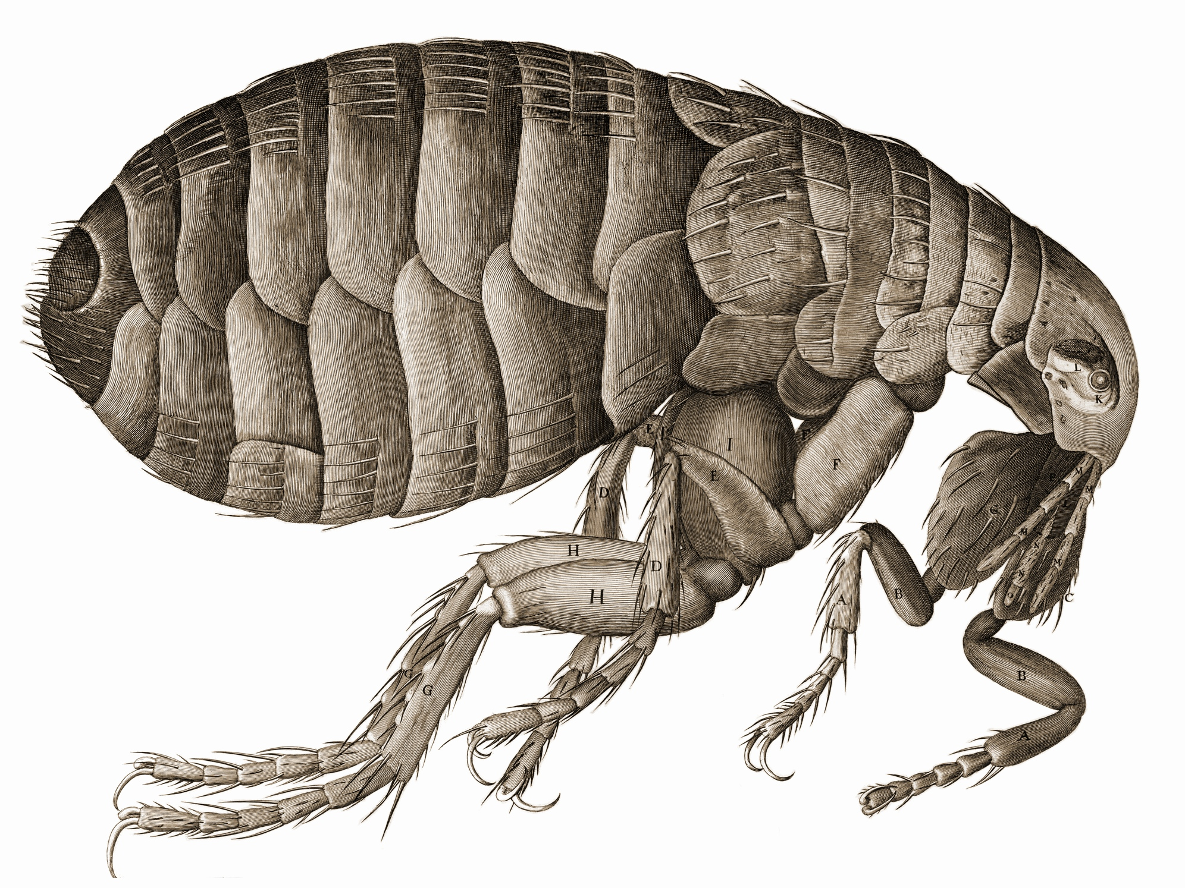
It can also be spread through the bite of infected fleas and rats.
Both pests could be found everywhere in medieval Europe.
Scientists now know that the Black Death, or the plague, is spread by a bacteria that travels from person to person through the air.

Slide 8
Historians believe that there were two different plagues at this time:
Bubonic plague:
The germ is carried in the bloodstream by rats. Fleas which bite the rats become infected and then pass on the plague when they bite humans. These fleas multiply in the warm weather but die off in the winter. It takes 4-7 days to die.
Pneumonic plague:
This plague is caught through breathing. It attacks the lungs. Patients cough blood and spray out germs when they breathe out. It kills people within 2 days.

Slide 9
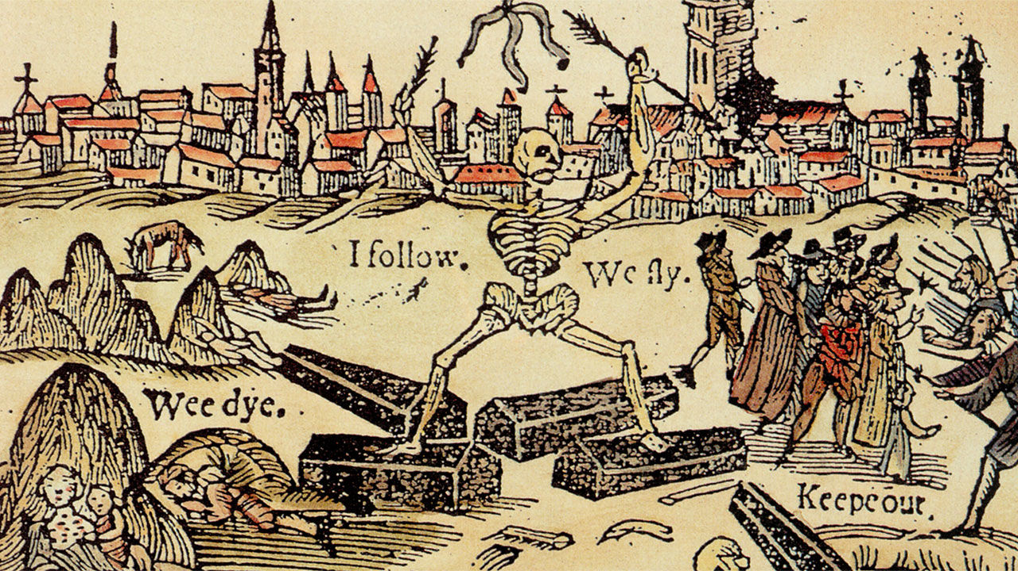
Healthy people did all they could to avoid getting sick.
Many people fled cities for the countryside.
But there was no escaping the plague.

Slide 10
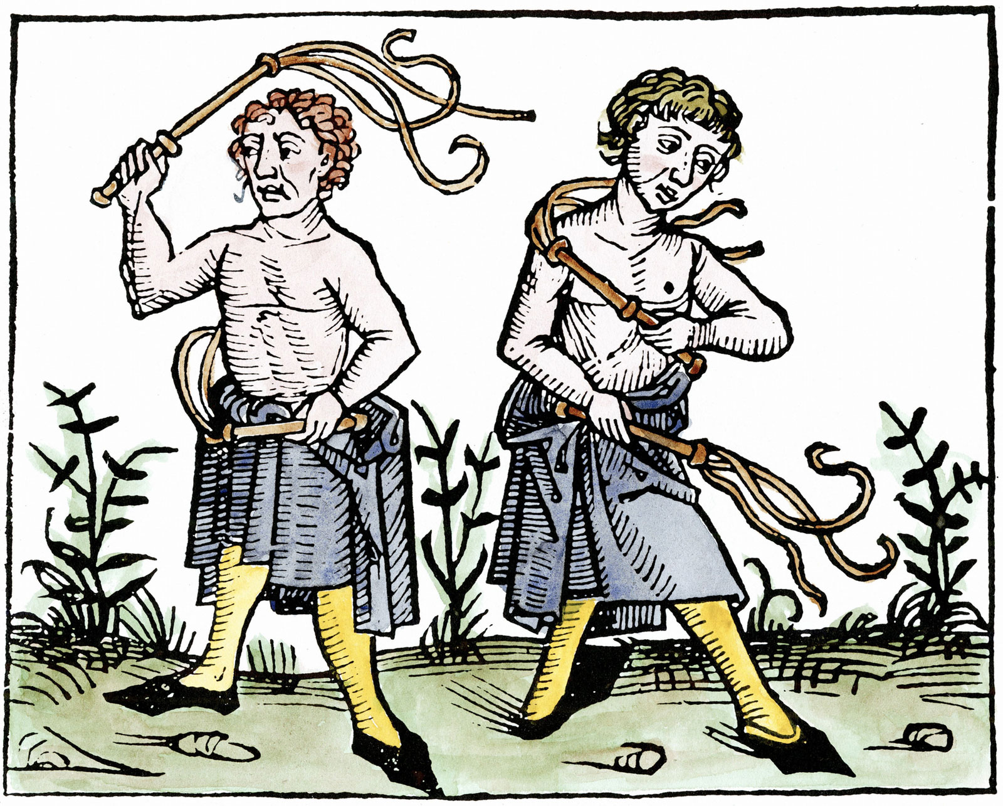
Some believed that the plague was a punishment from God for sinning.
In order to win God’s forgiveness, some engaged in public displays of penance and punishment.
Some were flagellants, a religious zealot. These people whipped themselves with heavy strips of leather studded with sharp pieces of metal.

Slide 11
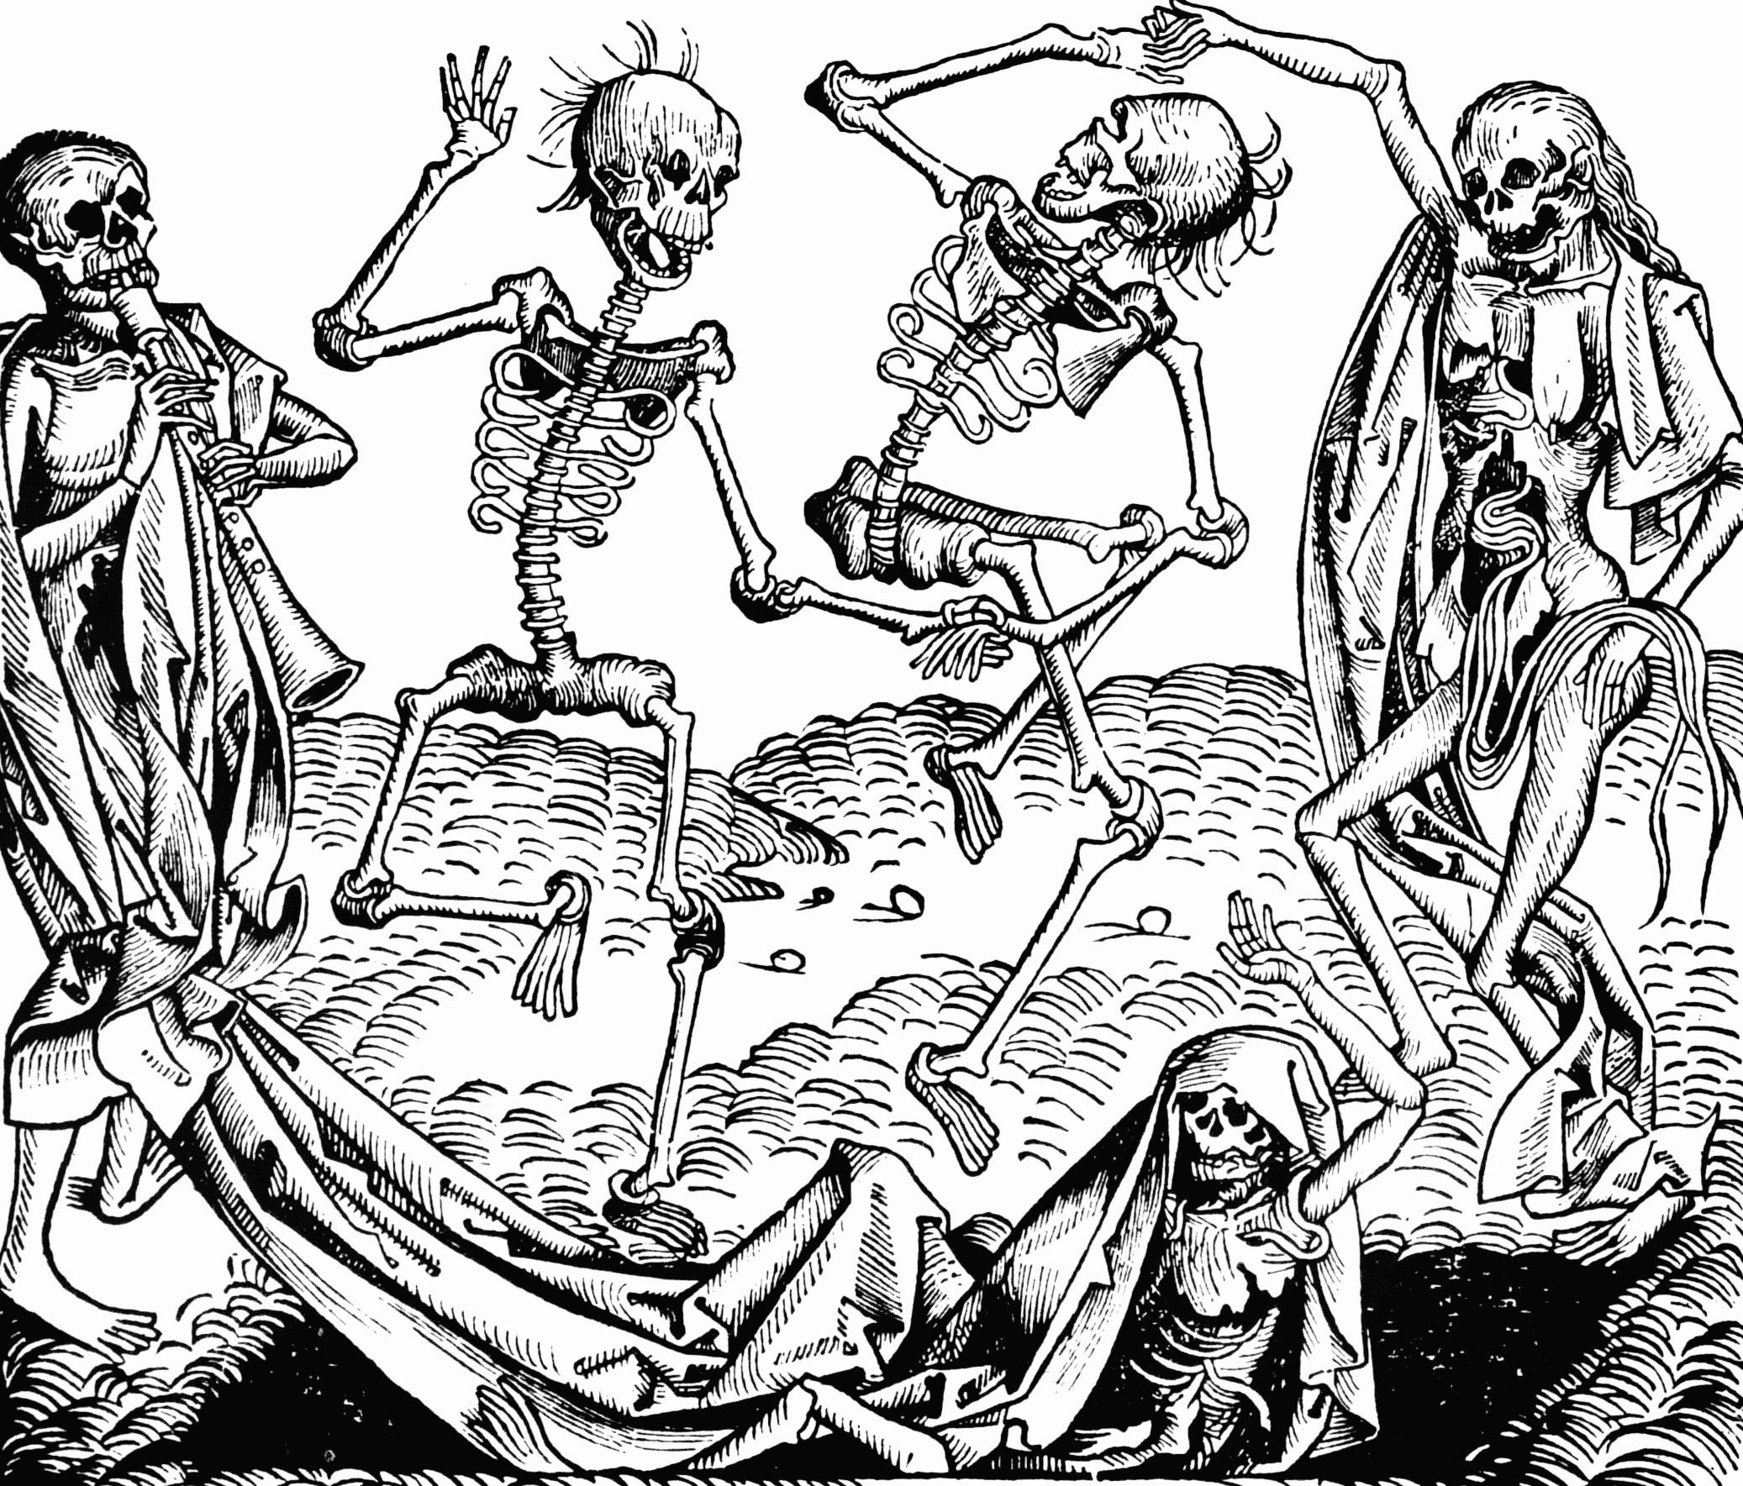
Art during this period had a fascination with death. Artists often used skeletons, some with bits of flesh still on their bodies.
For reasons that still puzzle historians today, some towns experienced groups of people that spontaneously began dancing. They would wildly dance for hours until they dropped to the ground from exhaustion.

Slide 12
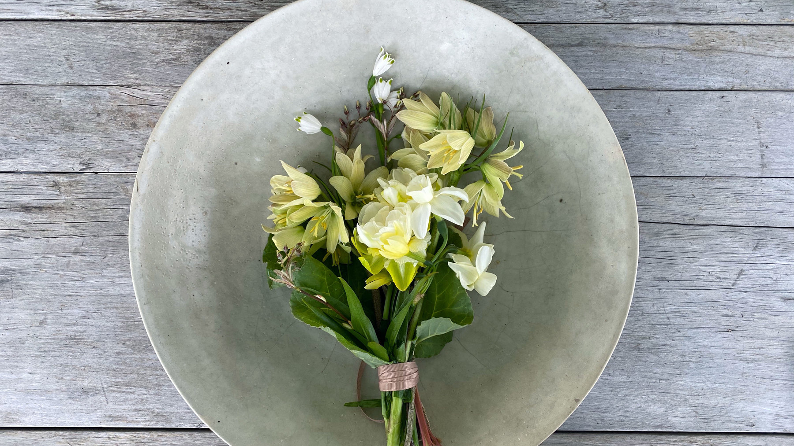
Do these lyrics look familiar?
The origins of the song go back to the plague!
Ring around the rosies
Pocket full of posies
Ashes, ashes
We all fall down!
Refers to praying the rosary or the red rosy sores that appeared on the body of those with the plague.
Posies are flowers. People during the plague kept flowers in their pockets to take out and put by their nose to avoid the foul smell of dead bodies in the streets.
Refers to burning the dead bodies that were lying in the streets. All that was left were ashes.
Refers to everyone dying.

Slide 13
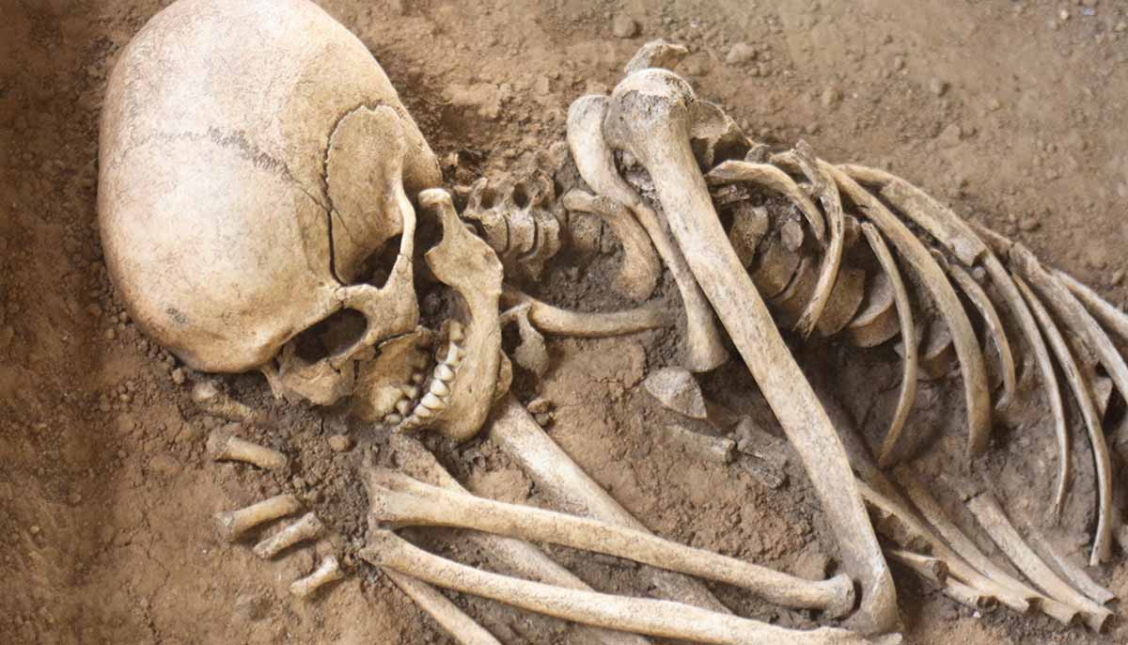
Officials in Italy eventually gained some control of the disease in their port cities by keeping arriving sailors in isolation until they knew they did not carry the sickness.
By creating social distancing via isolation, they were able to slow the disease.
The plague never really ended. It came back in a big way years later.

Slide 14
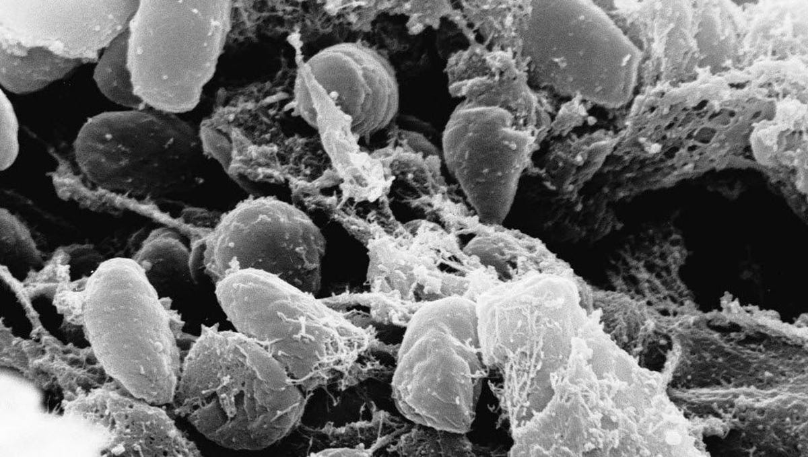
According to the World Health Organization, there are 1,000 to 3,000 cases of plague each year in the world today.
Fortunately, today we have antibiotics to help treat the disease.

